Slide 1
Can Corporate Debt Data be used to predict stock market routs ?
What are Corporate Credit Spreads and how are they measured:
Measured as the extra return an investor would make compared to a Treasury Bond (a Treasury bond is typically seen as a safe haven as it is debt issued and guaranteed by the government)
Corporates DO NOT borrow at the same levels as the government
The difference between the two borrowings (i.e. the interest rate difference) is the data we looked at !
Facts about the data used:
Source: Quandl.com (Financial database)
Pricing data:
B rated bonds index (The “B” is the rating given by rating agencies to borrowers – in this case we are looking at risky bonds)
Treasury Yields to derive the “spread” between the bonds and the benchmark (used the 5Y treasury for benchmarking).
S&P500 Index data
Analysis: Correlation between S&P500 & B-Rated Bond Index returns over time to generate buy/sell signals

Slide 2
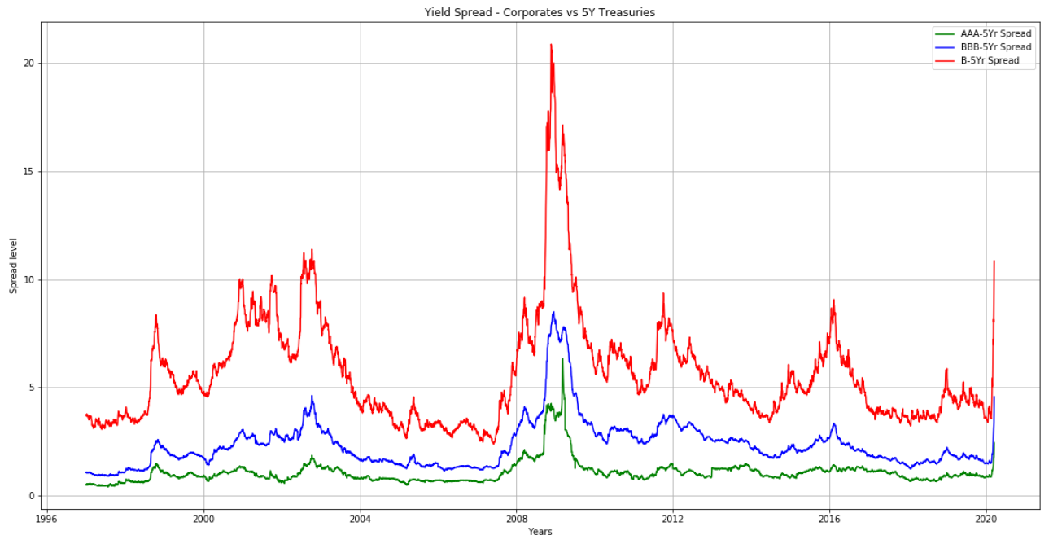
A Look at Spreads over time
Spreads tend to widen significantly during financial stress
This means that the cost of borrowing for these corporations is skyrocketing
Lenders (buyers of those bonds sell their holdings)
Bankruptcy risk rises as a result as credit conditions deteriorate

Slide 3
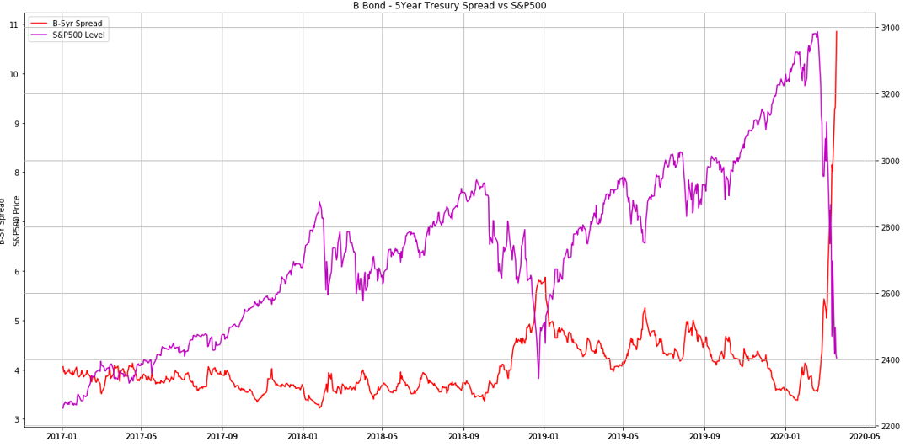
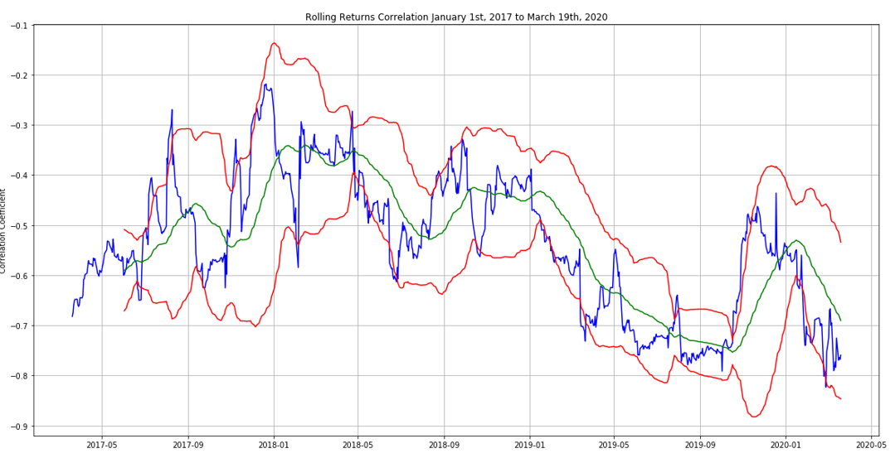
A closer look at the past 3 years…
The model seems to give reliable signals (buy/sell) in most cases.
The signal is given when the correlation hits +2/-2 standard deviations

Slide 4
Moving the research forward
While there seems to be some clear buy/sell signals on the S&P500 and this is a good starting point.
Some further analysis like the below could be conducted to use these signals in a production environment
Perform additional statistical testing specific to times series (in this case, we could test for mean reversion property)
Add filters to reduce the number of outliers – maybe adjust the signal with the standard deviation (Z-Score)
Add additional information from other markets (as we are only using spreads in this example) as this could lead to a trading model
Last but not least, we would need to run a full backtest (simulation of a trading strategy) and calculate the cumulative P&L of the strategy over time.

